Slide 1
NEA Specifications on Distribution Transformers
National Electrification Administration
Energizing the countryside, electrifying the future
FERDINAND P. VILLAREAL
8 JUNE 2015

Slide 2
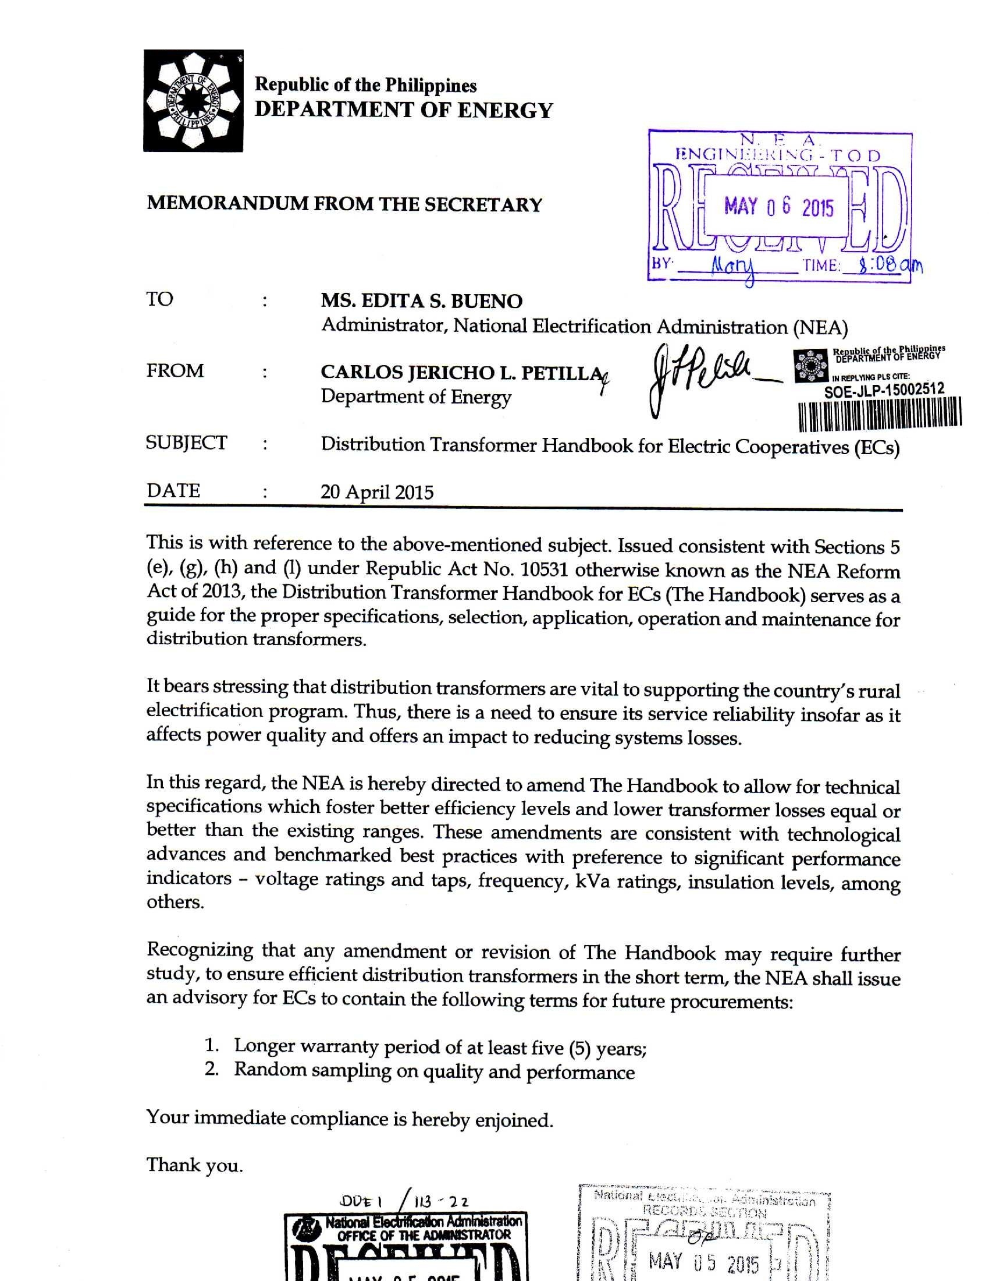

Slide 4
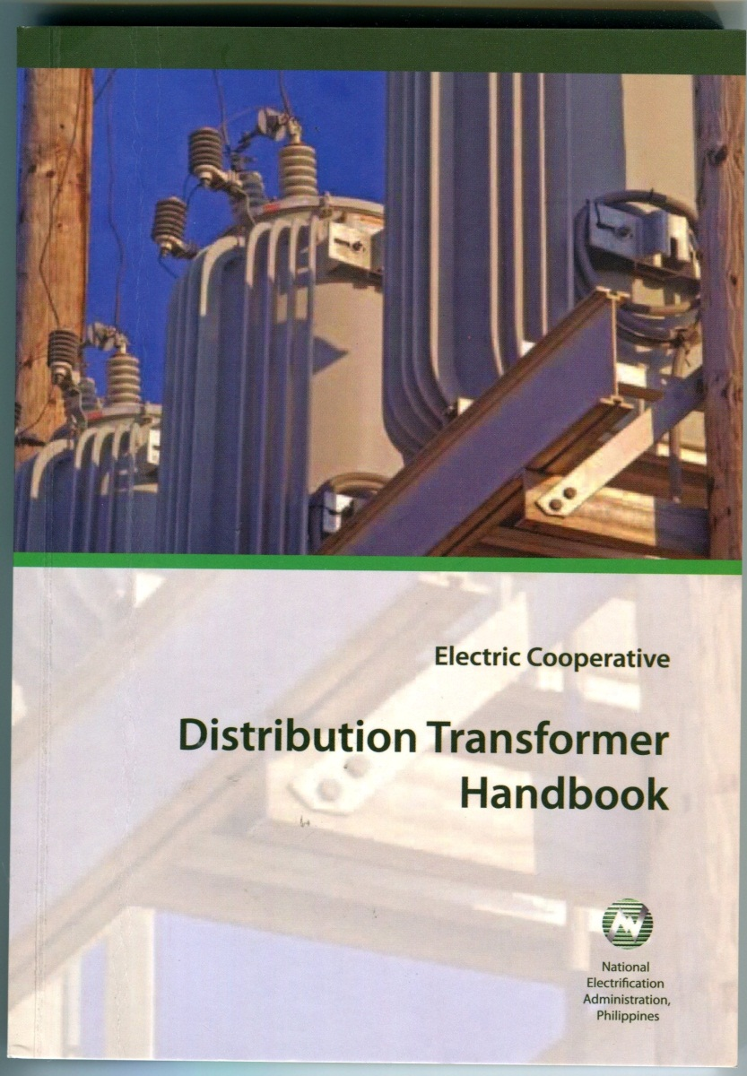
Background
A MOA between NEA and International Copper Association Southeast Asia (ICASEA) to harmonize the standards for the distribution system of Electric Cooperatives.
Such MOA resulted in the publication of the handbook which contains new transformer specifications and procurement guidelines.

Slide 5
Acknowledgements
NEA and ICASEA acknowledge the following:
Electric Cooperatives
UPEEEI Research and Development Foundation
UPNEC
United Nations Environment Programme

Slide 6
Technical Specifications
All transformers used by EC must conform to relevant standards of the following:
Institute of Electrical and Electronic Engineers (IEEE)
National Electrical Manufacturing Association (NEMA)
American Society for Testing Materials (ASTM)

Slide 7
Technical Requirements
Specification Requirements
The bidder shall propose a transformer based on the specification furnished by the Electric Cooperative. Any deviation from the specification shall be put in writing subject to the approval of the evaluating authority of the User.

Slide 8
Technical Requirements
Standards
Applicable Standards stated in the specification, including IEC standards, shall be the reference standards. Should the bidder propose a transformer made from other standards, it should equal or exceed the requirements of the Applicable Standards
The proposed standards shall be subject to the approval of the evaluating authority of the User. Only internationally standard shall be submitted as part of the tender documents.

Slide 9
Distribution Transformer Technical Information Sheet
 | REQUIRED | OFFERED
Name of supplier/manufacturer | To be specified
Place of manufacture | To be specified
Type of equipment | Distribution Transformer
Phase | Single-phase
Type of installation | Overhead-type, pole-mounted
Site and service conditions
• Maximum altitude above sea level | 1000m
• Maximum ambient temperature | 40° C
• Average ambient temperature | 30° C
Applicable standards | •IEEE Std C57.12.00 •IEEE Std C57.12.20 •IEEE Std C57.12.70 •IEEE Std C57.12.90 •ANSI/IEEE Std C57.92 •NEMA Std Pub. No. TRI •ASTM D3487

Slide 10
Distribution Transformer Technical Information Sheet
ELECTRICAL RATINGS | REQUIRED | OFFERED
Primary voltage rating | Any of the following as may be specified by the User: •22 860GrdY/13 200 V •22 860 V •13 200Grd Y/7620 V •13 200
Tap settings | One (1) - 2 1/2 % taps above and three (3) - 2 1/2 taps below rated primary voltage
Secondary voltage rating | Any of the following as may be specified by the User: •480/240 V •480 V •240/480 V •240 V
Frequency | 60 Hz
kVA rating | Any of the following as may be specified by the User: 3, 5, 10, 15, 25, 37.5, 50, 75, 100, 167, 250, or 333 kVA

Slide 11
Distribution Transformer Technical Information Sheet
Insulation Level (HV side) | REQUIRED | OFFERED
> Impulse Insulation, 1.2 x 50 µs wave
• Full Wave (BIL), crest | •For transformer rated 13 200 V and 13 200GrdY/ 7620 V = 95 kV •For 22 860GrdY/13 200 V and 22 860 V = 125 kV
• Chopped Wave, crest | •For transformer rated 13 200 V and 13 200GrdY/ 7 620 V = 105 kV •For 22 860GrdY/13 200 V and 22 860 V= 138 kV
• Minimum time to flashover . | •For transformer rated 13 200 V and 13 200GrdY/ 7 620 V = 1.8 µs •For 22 860GrdY/13 200 V and 22 860 V = 2.3 µs
Low-Frequency Voltage Insulation Level, 60Hz, 1 min, rms
• Applied Voltage Test (kV rms) | •For transformer rated 13 200 V = 34 kV •For 22 860 V = 40 kV
• Induced Voltage Test (kV rms) | •For transformer rated 13,200 V and 13,200GrdY/7 620 V = 17 kV, •For 22,860GrdY/13,200V and 22,860 V = 29kV

Slide 12
Distribution Transformer Technical Information Sheet
Insulation Level (LV side) | REQUIRED | OFFERED
• Full Wave (BIL), crest | 30 kV
• Chopped Wave, crest | 33 kV
• Minimum time to flashover | 1.0 µs
Low-Frequency Voltage Insulation Level, 60Hz, 1 min, rms
Applied Voltage Test (rms) | •For transformer rated 13 200 V = 34 kV •For 22 860 V = 40 kV
Induced Voltage Test (rms) | •For transformer rated 13 200 V and 13 200GrdY/ 7620 V= 17 kV •For 22 860GrdY/13 200 V and 22 860 V = 29kV
Percent Impedance | •3 thru 75 kVA = 2.0 ± 10% •100 thru 250 kVA = 3.0 ± 7.5% •333 kVA = 3.5 ± 7.5%

Slide 13
Distribution Transformer Technical Information Sheet
Losses | REQUIRED | OFFERED
• Reference temperature | •30°C for No-Load Losses •85°C for Load Losses
• Tolerance for Actual losses over Guaranteed losses | • 10% for No-Load losses • 6% for Total losses
• Limit for Total losses | Based on Table 5 of Distribution Transformer Technical Specification | _
Short-circuit rating | Per ANSI/IEEE C57.12.00
Loading Capability | Per ANSI C57.92 | _
Audible Sound Level limit | •50 kVA and below = 48 dB
 | •75 - 100 kVA = 51 dB
 | •167 - 250 kVA = 55 dB
 | •333 kVA = 56 dB

Slide 14
Distribution Transformer Technical Information Sheet
CONSTRUCTION | REQUIRED | OFFERED
Cooling Class | OA or ONAN
Core | •High-permeability, grain-oriented silicon steel OR •Amorphous Metal
Coil | High conductivity copper
Primary Bushing
• Number | •2 for transformer rated 13 200 V and 22 860 V •1 for transformer rated 13 200 Grd Y/7 620V and 22 860GrY/13 200 V
• Mounting | Cover-mounted
• Voltage class | •15 kV class for transformer rated 13 200 V and 13 200 Grd Y/7 620V •25 kV class for transformer rated 22 860GrdY/13 200 V and 22 860 V
• Creepage | •255 mm (10 in) for transformer rated 13 200 V and 13 200 Grd Y/7 620V •380 mm (15 in) for transformer rata 22 860GrdY/13 200 V and 22 860 V
• Color | ANSI 70 Gray
• Designation | •HI & H2 for transformer 13 200 V and 22 860 V •HI for transformer rated 13 200 Grd Y/7 620V and 22 860GrdY/13 200 V

Slide 15
Distribution Transformer Technical Information Sheet
• Insulation Level | REQUIRED | OFFERED
o 60 Hz, Dry One-Minute Withstand | •For transformer rated 13 200 V and13 200 Grd Y/7 620V =35 kV •For transformer rated 22 860GrdY/13 200 V and 22 860 V = 42 kV
o 60 Hz, Wet Ten-Second Withstand | •For transformer rated 13 200 V and13 200 Grd Y/7 620V =30 kV •For transformer rated 22 860GrdY/13 200 V = 36 kV
o Impulse, Full Wave Dry Withstand (1.2 x 50 ps) | •For transformer rated 13 200V and13 200 Grd Y/7 620V =95 kV •For transformer rated 22 860GrdY/13 200 V and 22 860 V = 125 kV
• Arrangement | Per IEEE Std C57.12.20
High-Voltage Neutral Bushing (only for transformers rated 13200 GrdY/7620V and 22 860GrdY/ 13 200 V)
• Number | 1
• Mounting | Side-wall mounted
• Insulation class | 1.2 kV class, 30 kV BIL
• Color | ANSI 70 Gray
• Designation | H2
• Grounding | Externally grounded to the tank wall using a removable copper ground strap

Slide 16
Distribution Transformer Technical Information Sheet
Secondary Bushings | REQUIRED | OFFERED
• Number | •For secondary rating of 240 V and 480 V = 2 •For 480/240 V = 3 •For 240/480 V = 4
• Mounting | Side-wall mounted
• Insulation class | 1.2 kV class, 30 kV BIL
• Color | ANSI 70 Gray
• Designation | XI, X2, X3, X4 (where applicable)
• Arrangement | Per ANSI C57.12.20
• Insulation Level
o 60 Hz, Dry One-Minute Withstand | 10kV
o 60 Hz, Wet Ten-Second Withstand | 6 kV
o Impulse, Full Wave Dry Withstand (1.2 x 50 Rs) | 30 kV
• Minimum cantilever force for 167 kVA and above | 40 kg

Slide 17
Distribution Transformer Technical Information Sheet
Bushing Terminals | REQUIRED | OFFERED
• HV bushing and HV Neutral bushing
o Type | Tinned copper-alloy eyebolt-type connector with stainless steel spring washer
o Conductor range | 8 mm² (AWG No. 8) solid to 30 mm² (AWG No. 2) stranded copper conductor
• LV bushing
o Type | •5-100 kVA = Tinned copper-alloy eyebolt-type connector with stainless steel spring washer •167-250 kVA = Tinned Spade H •333 kVA = Tinned Spade J
o Conductor range for transformers rated 240 V | •15 kVA & below = 14 mm² (AWG No. 6) solid to 100 mm² (AWG No. 4/0) stranded copper conductor •25-50 kVA = 30 mm² (AWG No. 2) solid to 700 mm² (350 kcmil) stranded copper conductor •75 kVA = 50 mm² (AWG No. 1/0) solid to 1 000 mm² (500 kcmil) stranded copper conductor •100 kVA = 60 mm² (AWG No. 2/0) solid to 2 000 mm² (1000 kcmil) stranded copper conductor •167-250 kVA = Spade H •333 kVA = Spade J
• Conductor range for transformers rated 240/480V, 480/240V, or 480V | •25 kVA & below = 14 mm² (AWG No. 6) solid to 100 m2 (AWG No. 4/0) 19 stranded copper conductor •37.5-100 kVA = 30 mm² (AWG No. 2) solid to 700 mm² (350 kcmil) 19 stranded •167-333 kVA = Spade H
•Terminal markings | Per ANSI C57.12.70

Slide 18
Distribution Transformer Technical Information Sheet
Polarity | REQUIRED | OFFERED
•Transformer rated 22 860 V, 13 200V and 22 860GrdY/13 200 V | Subtractive (all kVA ratings)
•Transformer rated 13200 Grd Y/7620V | •167 kVA & below = Additive •250-333 kVA = Subtractive
Tank
•Construction | Sealed-type with steel cover and reusable gasket
•Cover grounding | Copper ground strap connected to the tank body, sized for the short-circuit rating of the transformer
•Grounding
o Tank grounding | •Tinned copper alloy, eyebolt-type connector to accommodate 8 mm² (AWG No. 8) to 30 mm² (AWG No.2) stranded copper conductors •Located near the base of the tank | -
o HV neutral grounding (only for transformers rated 13200 Grd Y/7620V and 22 860GrdY/13 200V) | •Tinned copper alloy, eyebolt-type connector to accommodate 8 mm² (AWG No. 8) to 30 mm² (AWG No. 2) stranded copper conductors •Located near the HV neutral bushing •Provided with removable copper ground strap
• Support lugs | Per ANSI C57.12.20
• Lifting lugs | •Permanently attached near the top of the tank •Designed with safety factor of 5
• Core-coil lifting facility | Shall be provided | '
• Surge arrester mounting provision | Shall be provided per DT Technical Specifications
• Correct oil level marking | Shall be provided
• Tank color | ANSI 70 Gray, Munsell Notation 5BG7.0/0.4

Slide 19
Distribution Transformer Technical Information Sheet
Markings | REQUIRED | OFFERED
• kVA marking | Painted in black using 75 mm (3-inch) block letters and numerals, located below the low-voltage bushings
• Electric Cooperative Name Marking (only when required) | Embossed 75 mm (3-inch) block letters, located below the kVA marking
• Equipment Identification Number (only when required) | Painted in black using 50 mm (2-inch) block letters and numerals, located below the Electric Cooperative Name Marking
Tap Changer
• Design | Provided with an external operating handle mounted on the tank wall
• Operation | •De-energized operation only •Clockwise direction from the highest to the lowest tap position
• Markings
o Tap positions and Caution sign | •Tap positions marked with reflectorized, non-weathering decals at least 25 mm (1.0 inch) high, with numeral "1" assigned to the highest tap •Caution marking: Do Not Operate When Energized

Slide 20
Distribution Transformer Technical Information Sheet
Pressure Relief Valve | REQUIRED | OFFERED
• Design | •Provided with a pull ring for manually reducing pressure to atmospheric level using a standard hot-stick. •It shall be capable of withstanding a static pull force of 11.34 kg (25 pounds) for one minute without permanent deformation.
• Venting and Characteristics | •Venting pressure = 69 kPa (10 psig) ± 13 kPa (gauge) (2 psig) •Resealing pressure = 42 kPa (gauge) (6 psig) minimum •Zero leakage from reseal pressure to -56 kPa (gauge) (8 psig) •Flow at 103 kPa (gauge) (15 psig) = 16.5 L/s (35 SCFM) minimum, corrected for air pressure of 101 kPa (14.7 psi) (absolute) and air temperature of 21°C
Enclosure Integrity | •Completely assembled transformer enclosure shall be of sufficient strength to withstand an internal pressure of 49 kPa (gauge) (7 psig) without permanent distortion •Can withstand an internal pressure of 138 kPa (gauge) (20 psig) without rupturing or displacing components (excluding the cover gasket and gasket oil leaks) of the transformer
Insulating Liquid | Unused mineral oil meeting the requirements of the latest revision of ASTM D3487
Hardware (bolts, nuts and washers° | •All energized hardware shall be made of tinned copper alloy material. •All other hardware shall be hot-dip galvanized.

Slide 21
Distribution Transformer Technical Information Sheet
Nameplate | REQUIRED | OFFERED
• Material | Stainless Steel
• Information | •Percent impedance •BIL •Total weight, kg •Connection diagram •Name of manufacturer •Installation and operating instructions reference •The word 'Transformer' •Type of insulating liquid (generic name) •Conductor material for each winding •Equipment identification number

Slide 22
Distribution Transformer Technical Information Sheet
Tests | REQUIRED | OFFERED
Routine tests | •Winding resistance measurement tests •Ratio Test •Polarity Test and Phase Relation •No-load Losses and Excitation Current at rated voltage and frequency •Impedance Voltage and Load Loss Measurement •Induced Potential Test (Low- frequency Dielectric Test) •Dielectric Test of Insulating Oil •Mechanical (Leak Test)
Design (or Type) tests | Certified test reports to be submitted: •Temperature Rise •Lightning Impulse •Insulation Power Factor •Insulation Resistance •Short-Circuit Capability

Slide 23
Nameplate Information
Serial Number | BIL
Class | Total weight, kg
Number of phases | Connection diagram
Frequency | Name of manufacturer
Voltage rating | Installation and operating instruction reference
kVA rating | The word “Transformer”
Temperature rise, oC | Type of insulating liquid (generic name)
Polarity | Conductor material for each winding
Percent Impedance | Equipment identification number

Slide 24
Table 5. Transformer Maximum Losses
Rating | Silicon Steel Core |  |  |  | Amorphous Metal Core
 | No Load Losses, Watts | Load Losses, Watts | Total Losses |  | No Load Losses, Watts | Load Losses , Watts | Total Losses
 |  |  | Watts | % of Rated kVA |  |  | Watts | % of Rated kVA
3 | 9 | 45 | 54 | 1.80 | 8 | 45 | 53 | 1.76
5 | 19 | 75 | 94 | 1.88 | 8 | 75 | 83 | 1.66
10 | 36 | 120 | 156 | 1.56 | 12 | 120 | 132 | 1.32
15 | 50 | 195 | 245 | 1.63 | 15 | 195 | 210 | 1.40
25 | 80 | 290 | 370 | 1.48 | 18 | 290 | 308 | 1.23
37.5 | 105 | 360 | 465 | 1.24 | 30 | 360 | 390 | 1.04
50 | 135 | 500 | 635 | 1.27 | 32 | 500 | 532 | 1.06
75 | 190 | 650 | 840 | 1.12 | 45 | 650 | 695 | 0.93
100 | 210 | 850 | 1060 | 1.06 | 50 | 850 | 900 | 0.90
167 | 350 | 1410 | 1760 | 1.05 | 65 | 1410 | 1475 | 0.88
250 | 500 | 2000 | 2500 | 1.00 | 90 | 2000 | 2090 | 0.83
333 | 650 | 2500 | 3150 | 0.94 | 120 | 2500 | 2620 | 0.79

Slide 25
Table 6. Audible Sound Level
kVA | Average Sound Lever (Decibels)
50 and below | 48
75 - 100 | 51
167 -250 | 55
333 | 56

Slide 26
Warranty
The supplier/manufacturer shall warrant its transformers to be free of defects in material and workmanship for a period not to exceed
twelve (12) months from the date of initial installation or
eighteen (18) months from the date of delivery.
In the event of breakdown within the period of warranty, the User shall inform the manufacturer within 30 working days.
When duly informed, the manufacturer shall promptly investigate, repair or replace the transformer, if necessary.
All replacements shall be made within 60 days from receipt of the first notice of the User.
The User may impose a penalty to the supplier for each day of delay beyond the 60-day limit

Slide 27
Thank you!

